Slide 1


Temperature & Air Humidity Forecasting

Slide 2
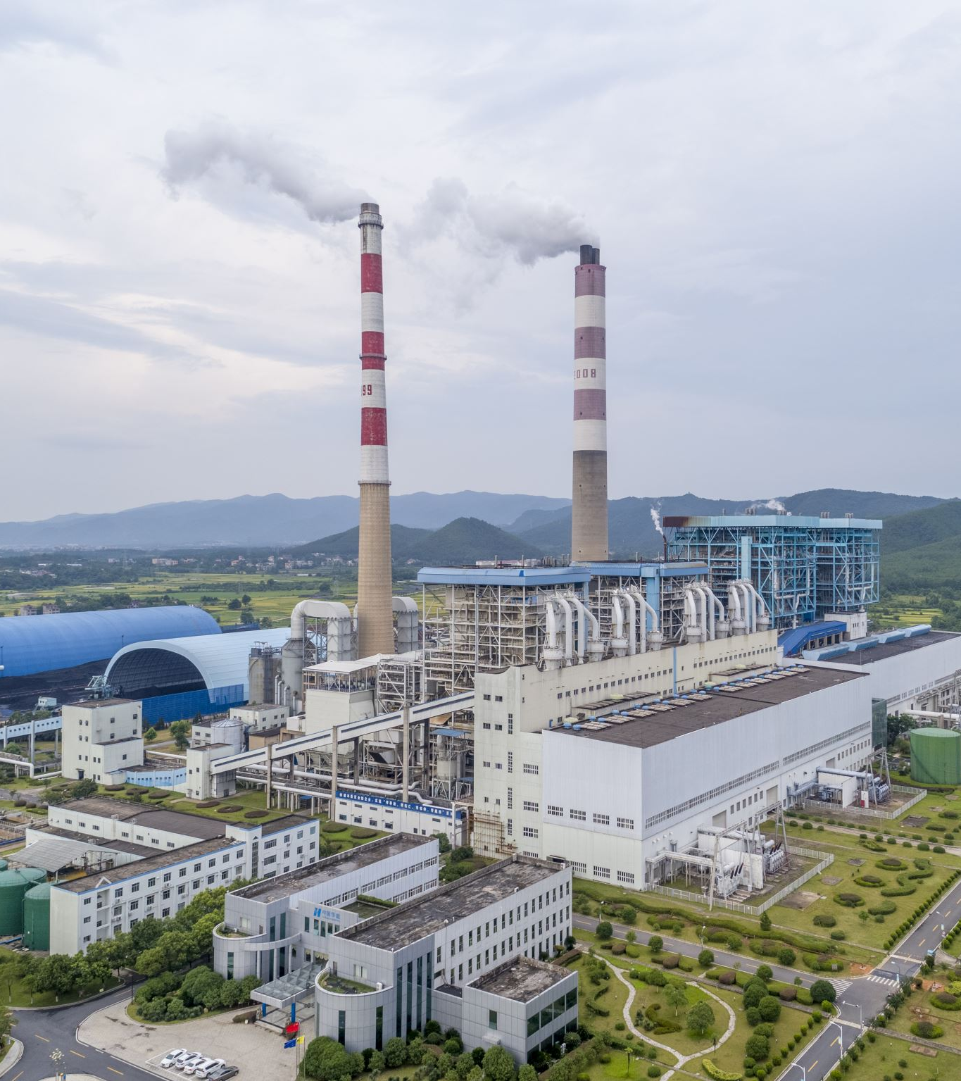
Introduction
Temperature and air humidity are two critical environmental factors that impact various aspects of our daily lives, including health, agriculture, and energy consumption.
Accurate forecasting of temperature and air humidity can provide valuable insights into weather patterns and assist in decision-making related to agriculture, energy consumption, and transportation.
Notes:
Air quality has worsened due to rapid industrialization and urbanization, posing health and environmental risks. To predict air pollution, models use maximum temperature and absolute humidity as factors. This suggests that tackling rising temperature and humidity can help reduce pollution. High levels of NOx, a pollutant, are linked to high temperatures. Under-forecasting temperature indicates global warming. Regulations must consider these factors to be effective and encourage compliance.

Slide 3
Problem Statement
The problem statement for this data mining project is to develop a model that can accurately forecast temperature and air humidity trends in a specific region in Italy depending on the toxic gases(CO, Nox, NO2). The challenge lies in identifying the patterns and trends in the historical data that can be used to develop a predictive model that can forecast future changes with a high degree of accuracy.
Notes:
Gas test analyser has been installed in btw the city, hence we have not considered variables from the arbitrary unit. ( every city has arbitrary unit, which detects the air quality , generally these arbitrary units are away from the city, hence there are chances of manipulation in the data).

Slide 4
Literature
what they did:
Didnt group the dataset by Dates
They forecasted only temperature.
Built a Random forest model
They considered data from arbitrary units and reference analyzer unit
What we did:
We grouped by dates
We forecasted for temperature and Absolute humidity
We modeled with ARIMA
WE have considered only data from reference Analyzer units

Slide 5
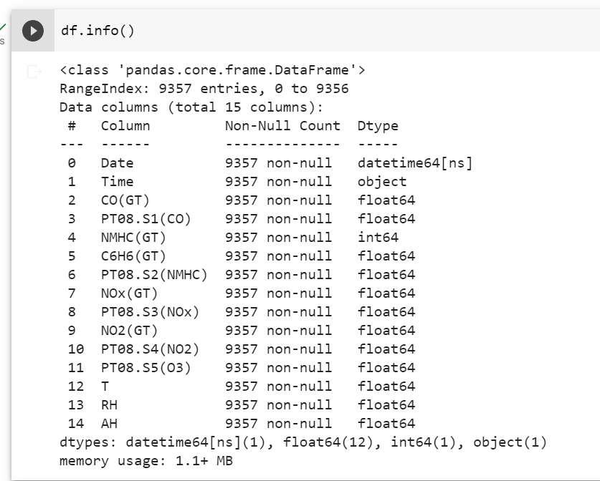
Dataset Description
Source of Dataset: Kaggle.
Our datasets contain 9357 rows and 14 columns.
The columns include several pollutants of CO, PT08.S1 (tin oxide), NMHC (Metain Hydrocarbons), C6H6 (Benzene), PT08.S2 (Titiania), NOx, PT08.S3 (tungsten oxide), NO2, PT08.S4, PT08.S5

Slide 6
Column Name | Descriptions
Date | Date (DD/MM/YYYY)
Time | Time (HH.MM.SS)
CO(GT) | True hourly averaged concentration CO in mg/m^3 (reference analyzer)
PT08.S1(C0) | (tin oxide) hourly averaged sensor response (nominally CO targeted)
NMHC(GT) | True hourly averaged overall Non Metanic HydroCarbons concentration in microg/m^3 (reference analyzer)
C6H6(GT) | True hourly averaged Benzene concentration in microg/m^3 (reference analyzer)
PT08.S2(NMHC) | (titania) hourly averaged sensor response (nominally NMHC targeted)
NOx(GT) | True hourly averaged NOx concentration in ppb (reference analyzer)
PT08.S3(N0x) | (tungsten oxide) hourly averaged sensor response (nominally NOx targeted)
NO2(GT) | True hourly averaged NO2 concentration in microg/m^3 (reference analyzer)
PT08.S4(NO2) | (tungsten oxide) hourly averaged sensor response (nominally NO2 targeted)
PT08.S5(NO2) | (indium oxide) hourly averaged sensor response (nominally O3 targeted)
T | Temperature in Â°C
RH | Relative Humidity (%)
AH | Absolute Humidity
Notes:
Co,no2,nox- independent t,ah- dependent
C6h6,nmhc,rh-these don’t have any impact hence removed them
pt08,.s1,pt08.s2,s3,s4,s5 – arbitrary analyser hence removed them

Slide 7
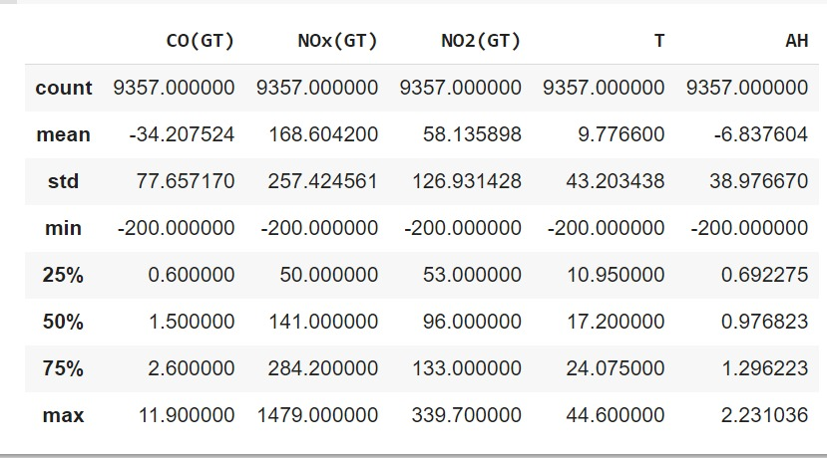
Dataset Summary

Slide 8

Data Cleaning

Slide 9
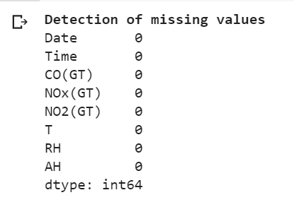
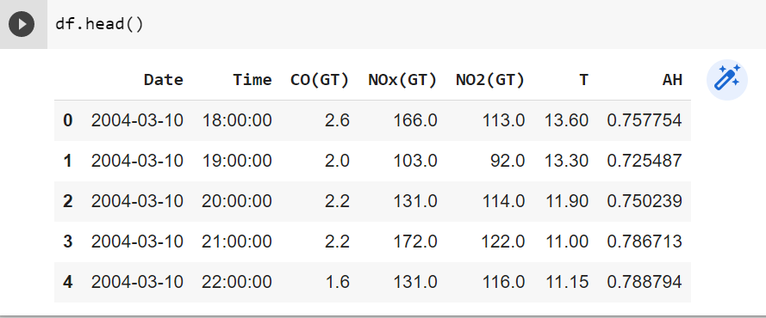
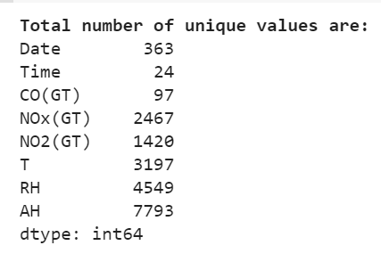
Column Elimination

Slide 10
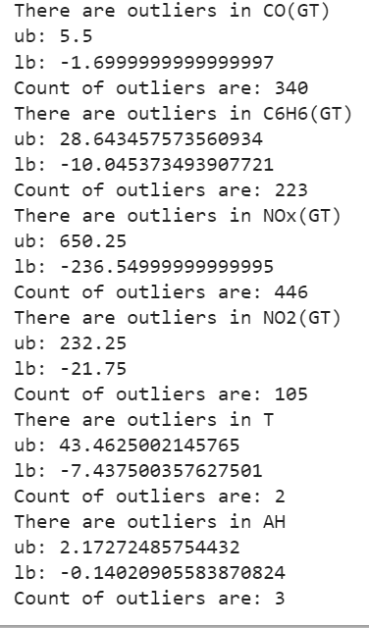
Outlier Treatment - replacing outliers with mean of outliers of that column

Slide 11
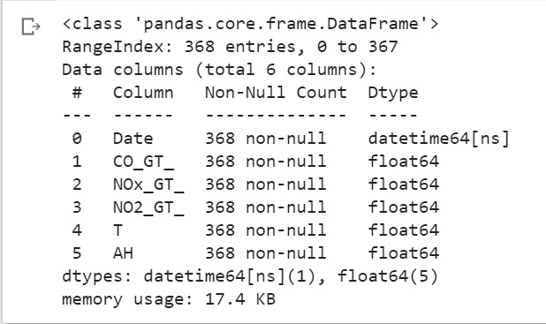
Data Before Preprocessing
Data After Preprocessing

Slide 12
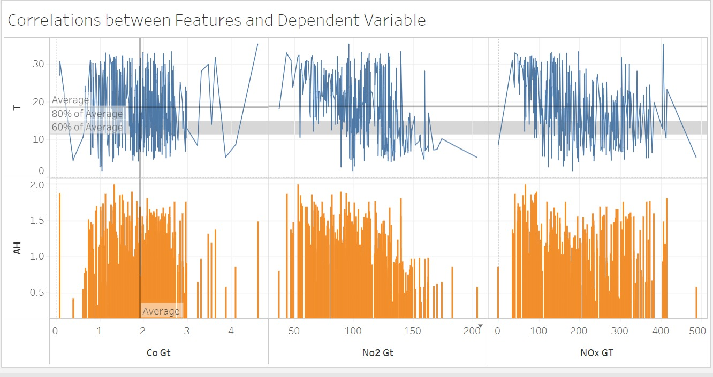
Data Visualization

Slide 13
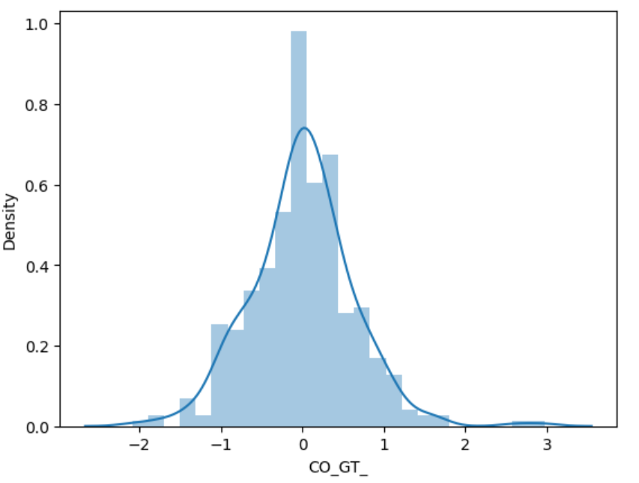
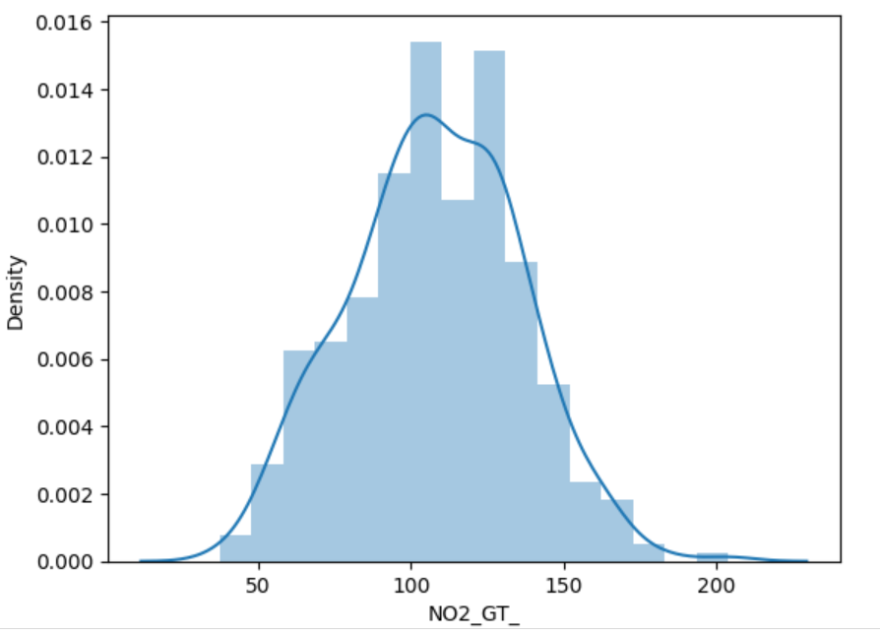
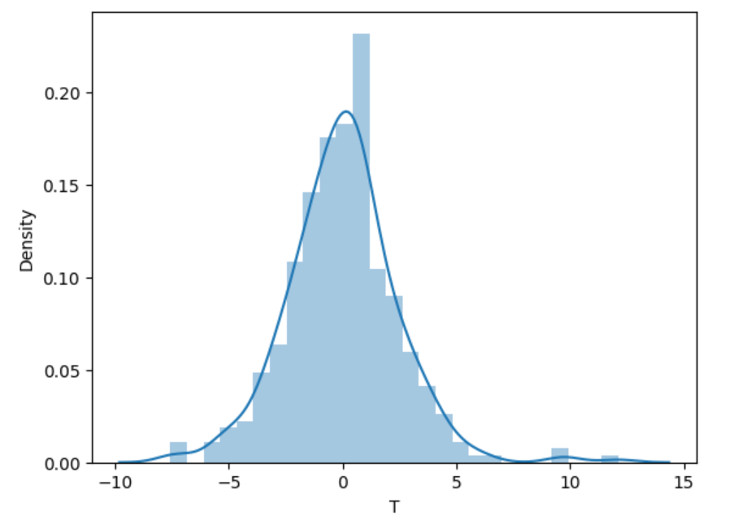
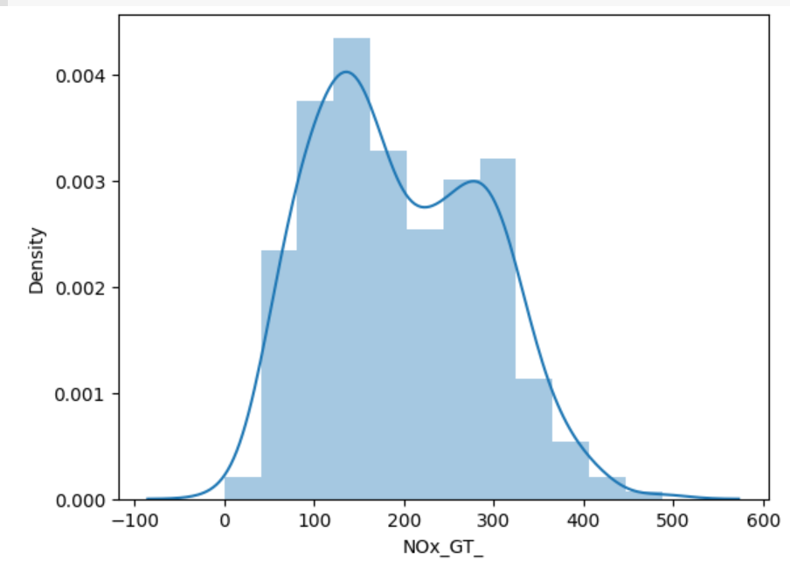
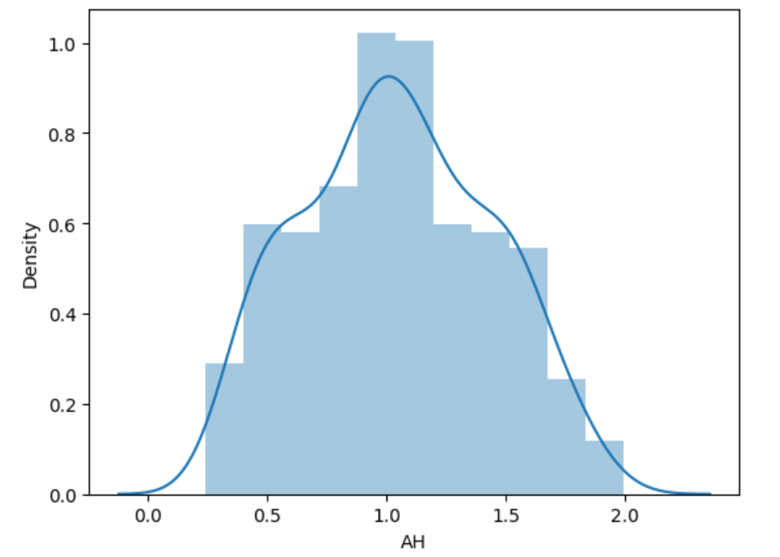
Features Skewness Exploration

Slide 14
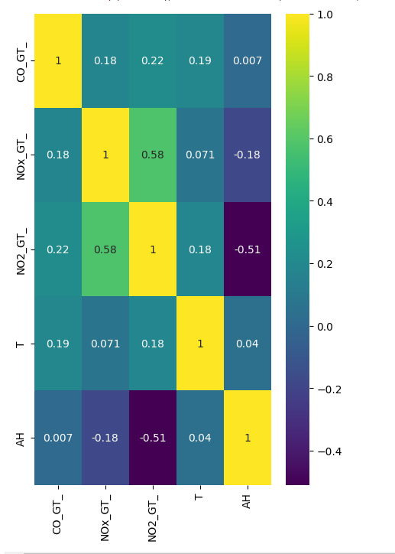
Correlation Matrix

Slide 15
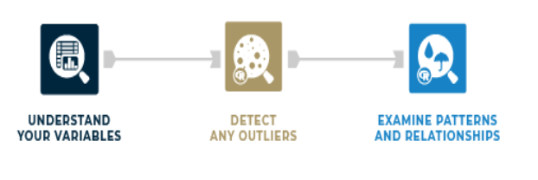
Data Exploration

Slide 16
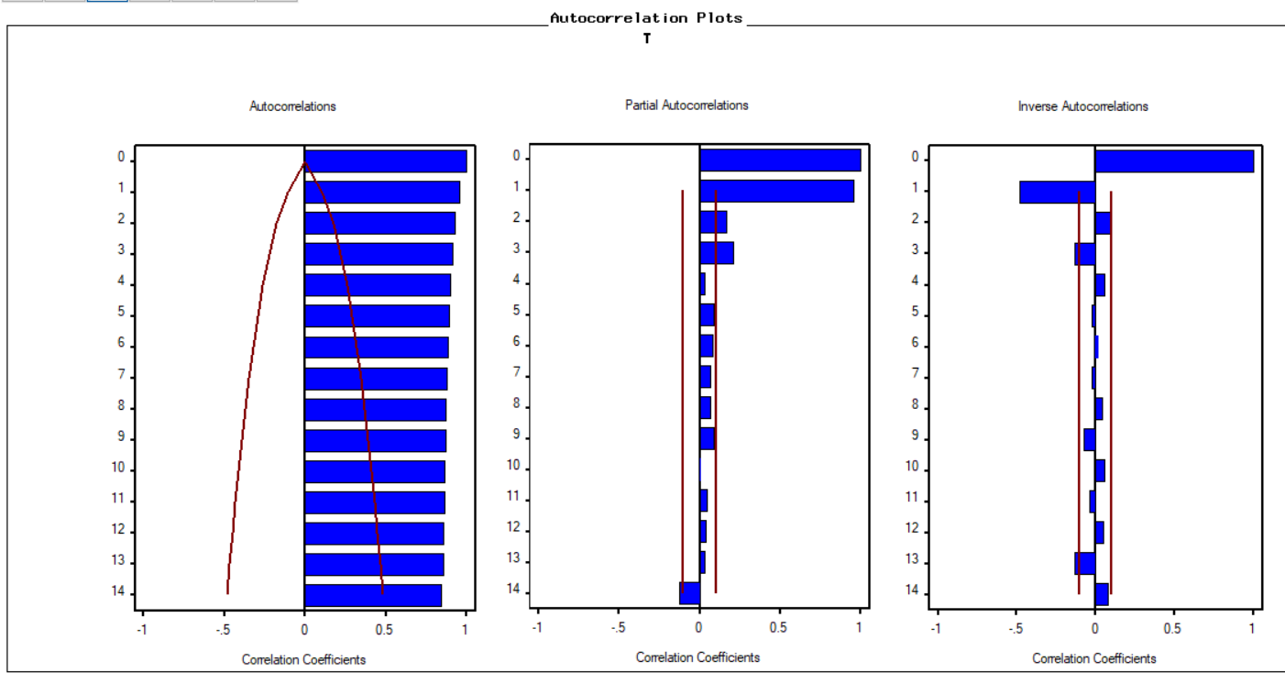
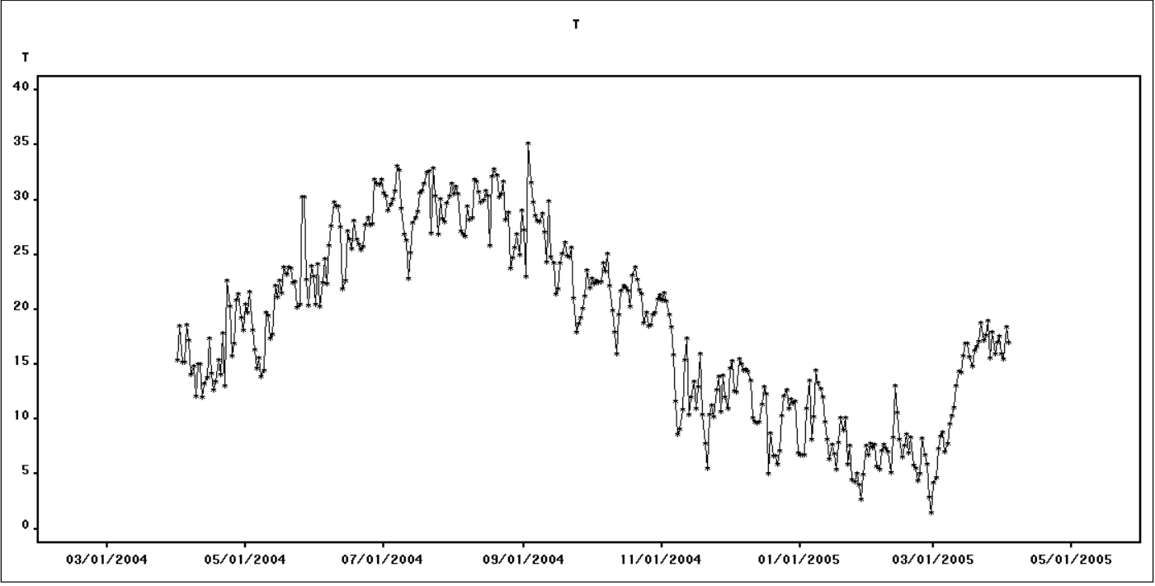
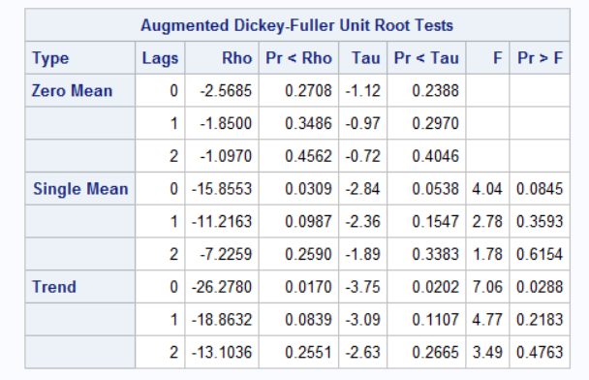
Trend Cycle of AvgT
Have taken Average of T

Slide 17
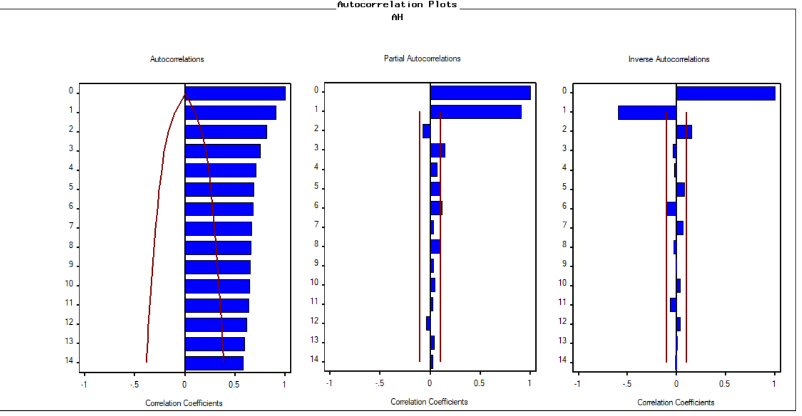
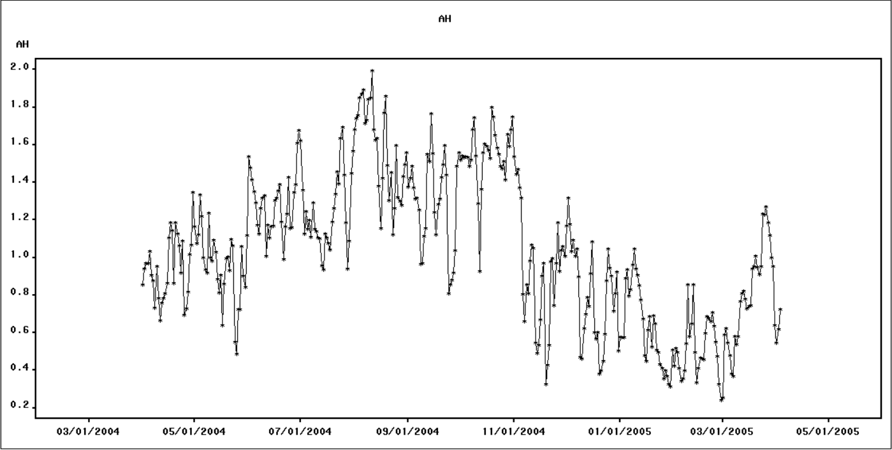
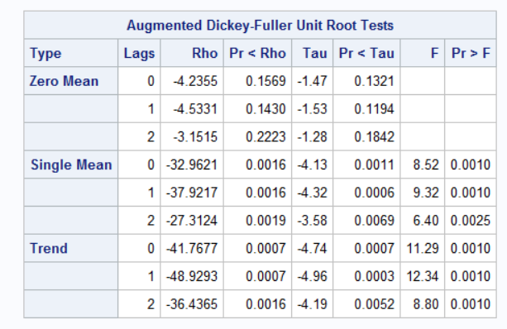
Trend Cycle for AH

Slide 18
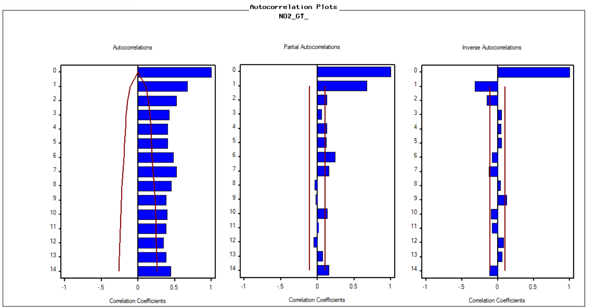
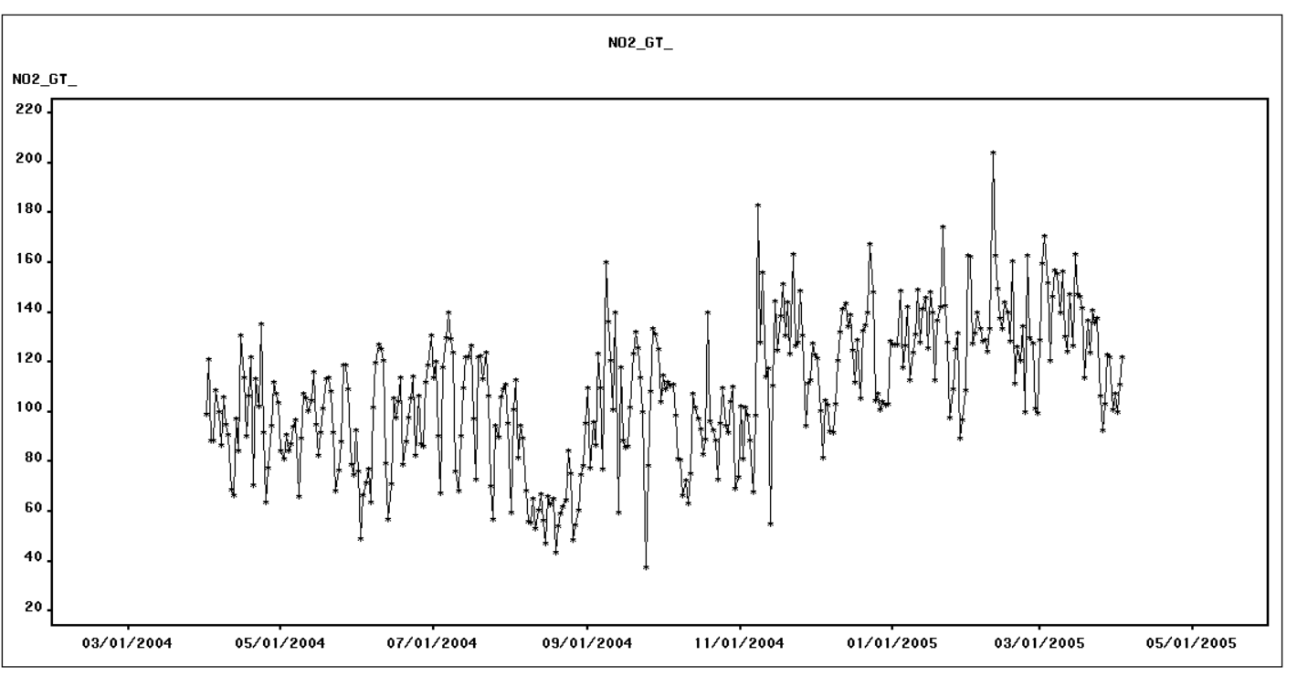
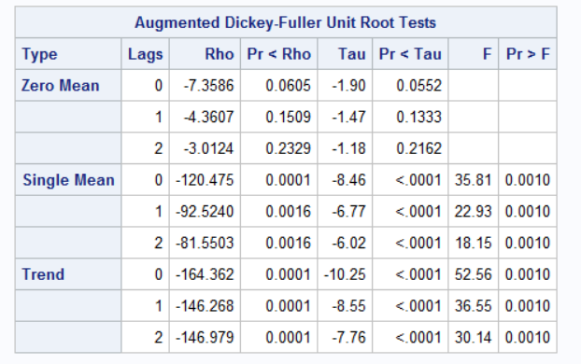
Trend Cycle for NO2 GT

Slide 19
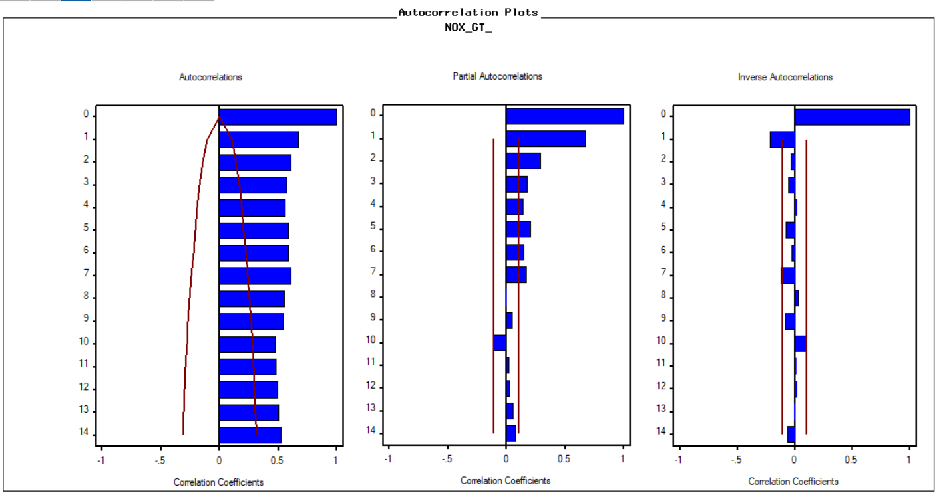
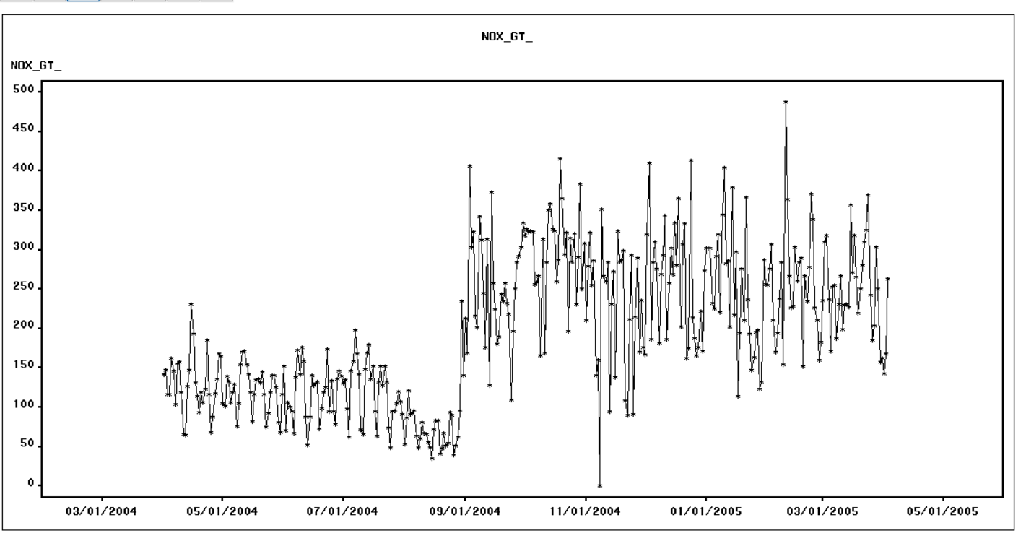
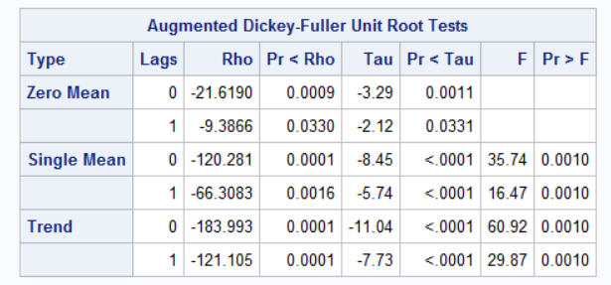
Trend Cycle for NOxGT

Slide 20
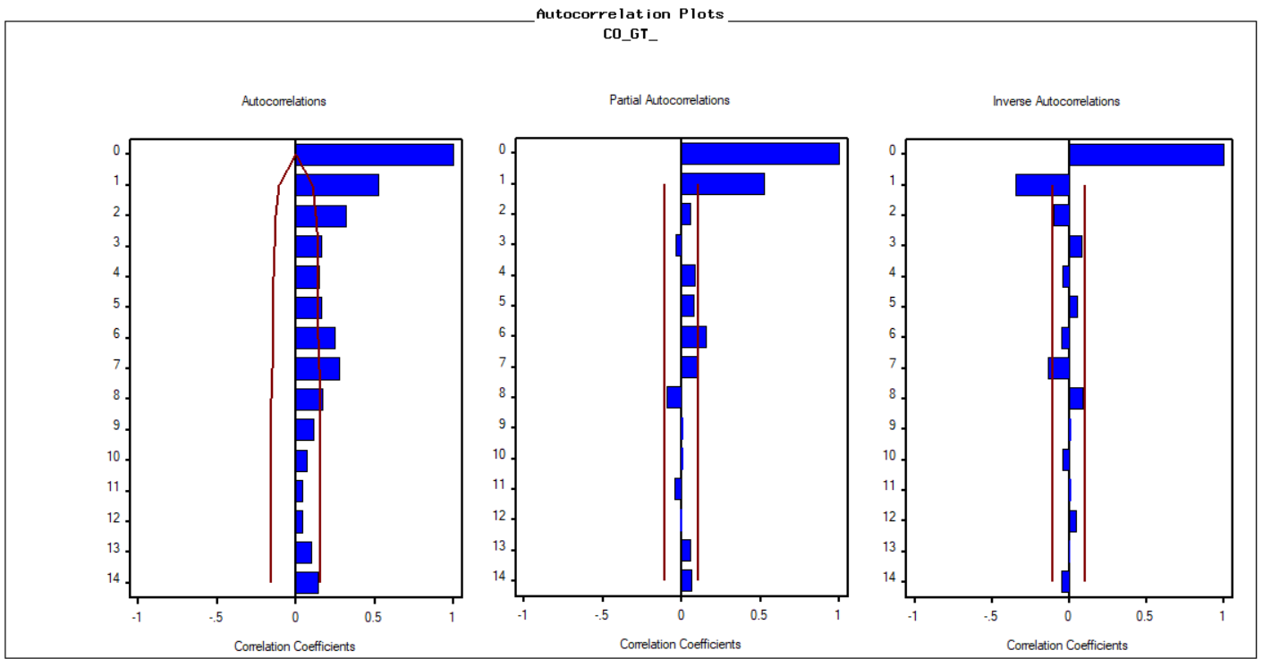
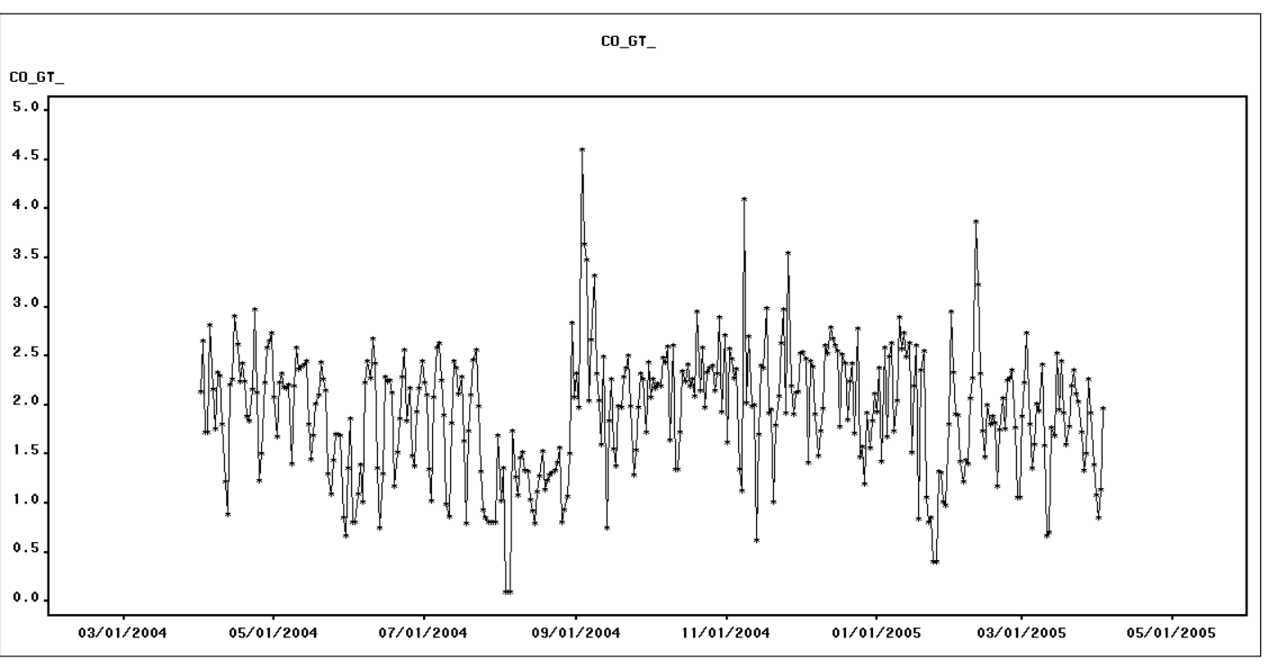
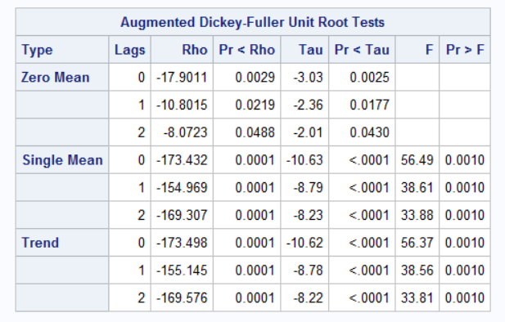
Trend Cycle for CO_GT

Slide 21

Modeling

Slide 22
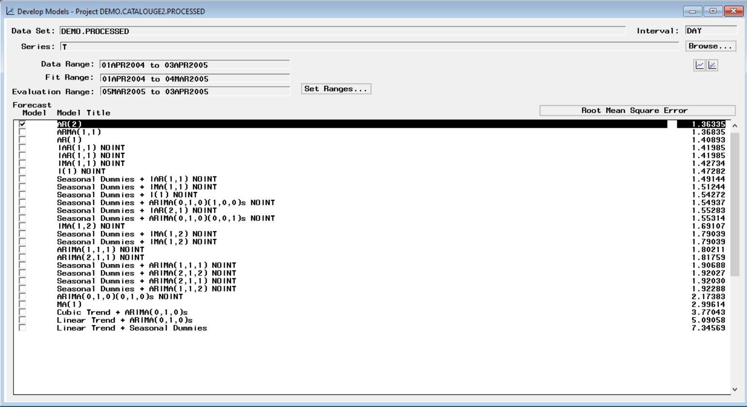
Modeling ARIMA for T

Slide 23
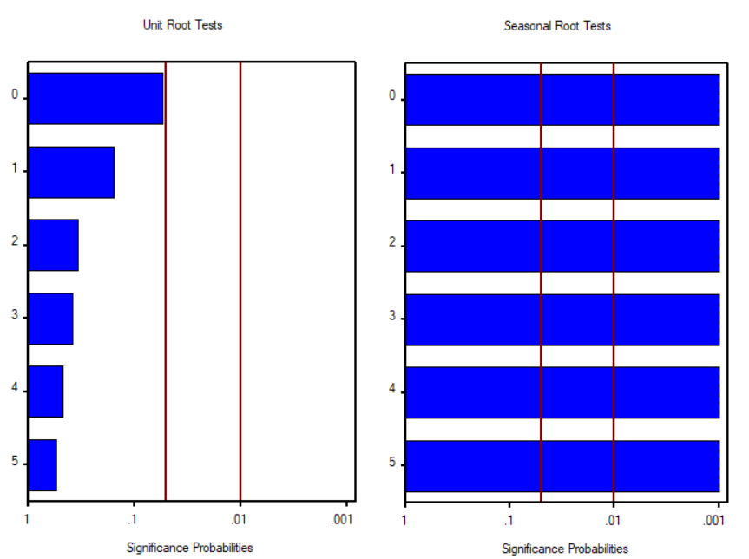
Stationary Check Before Modeling

Slide 24
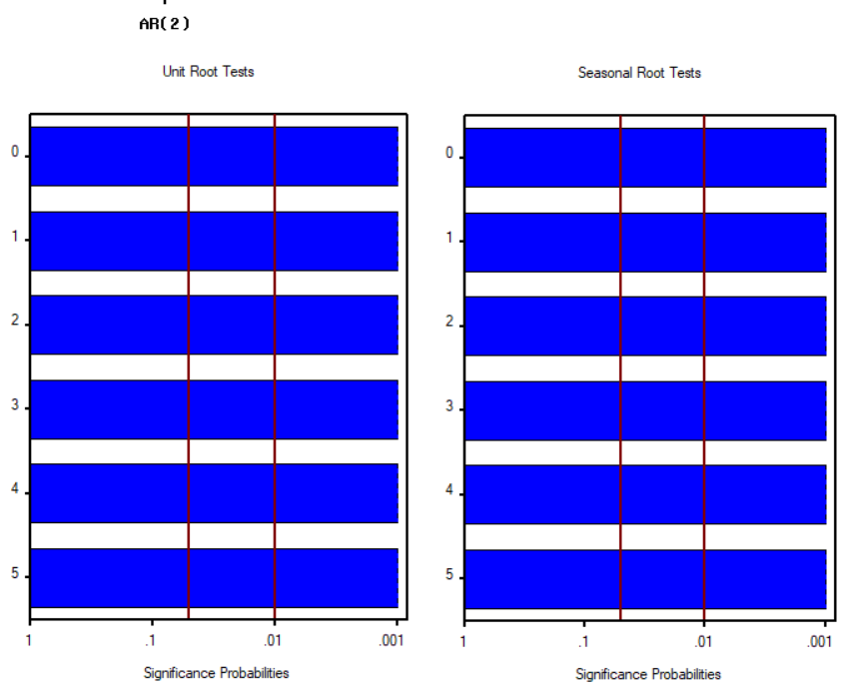
Stationary Checks After Modeling

Slide 25
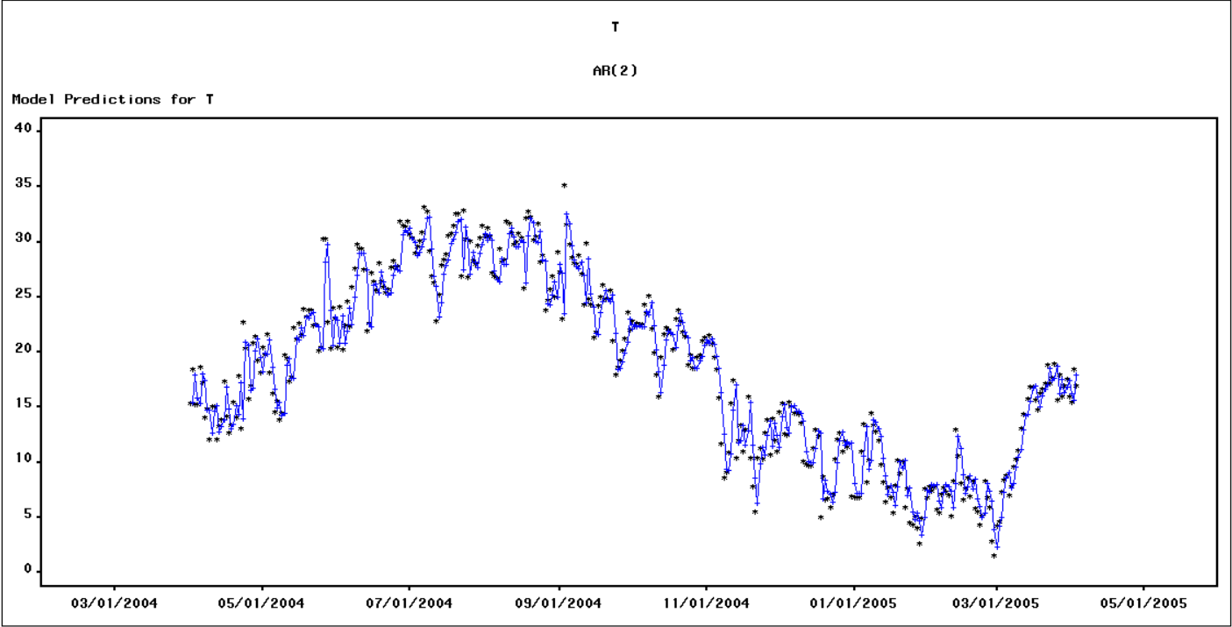
Model Prediction for T

Slide 26
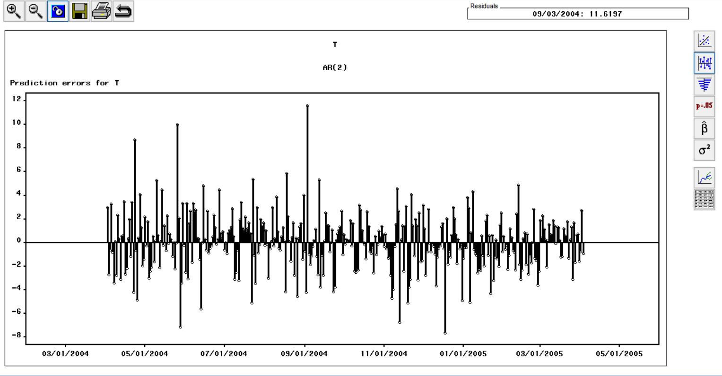
RMSE: 1.36335 MAPE: 8.06124 MAE: 1.15248 Mean Sq: 1.85872 R Sq: 0.826
Best Model: AR2

Slide 27
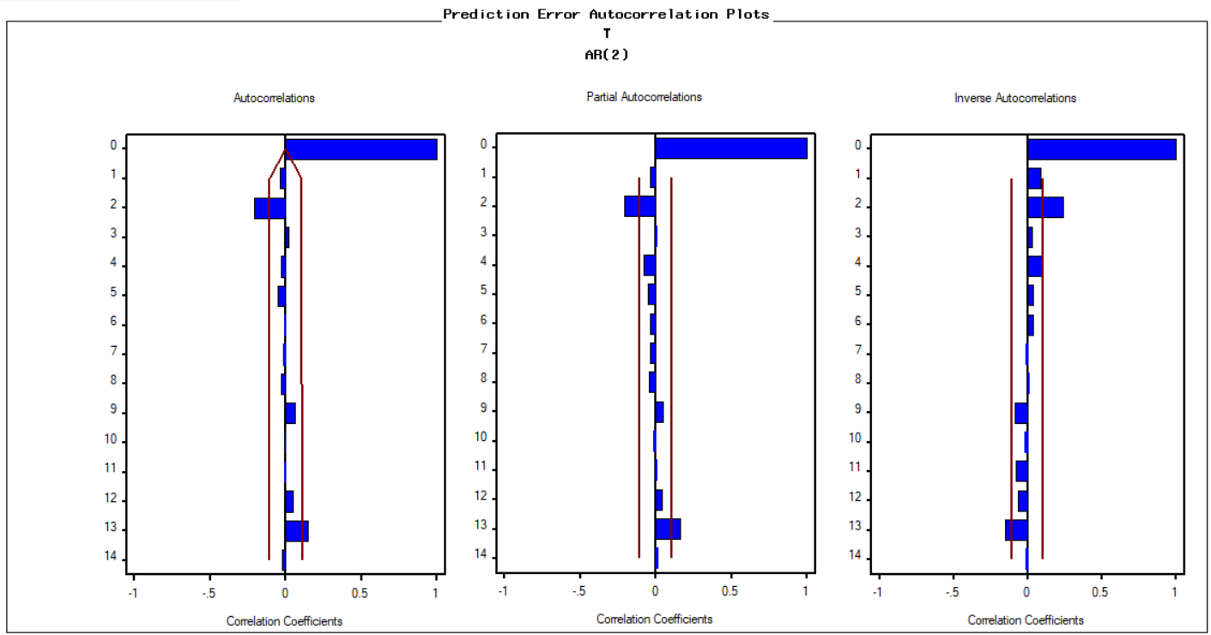
Prediction Errors

Slide 28
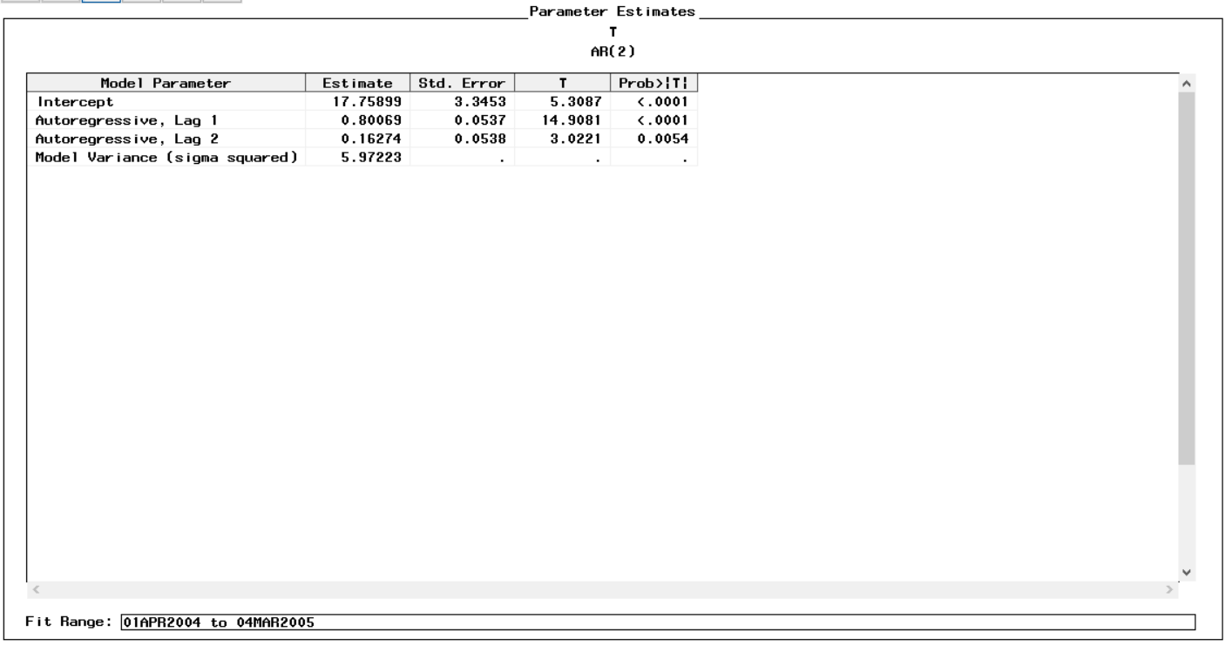
Parameter Estimates for T

Slide 29
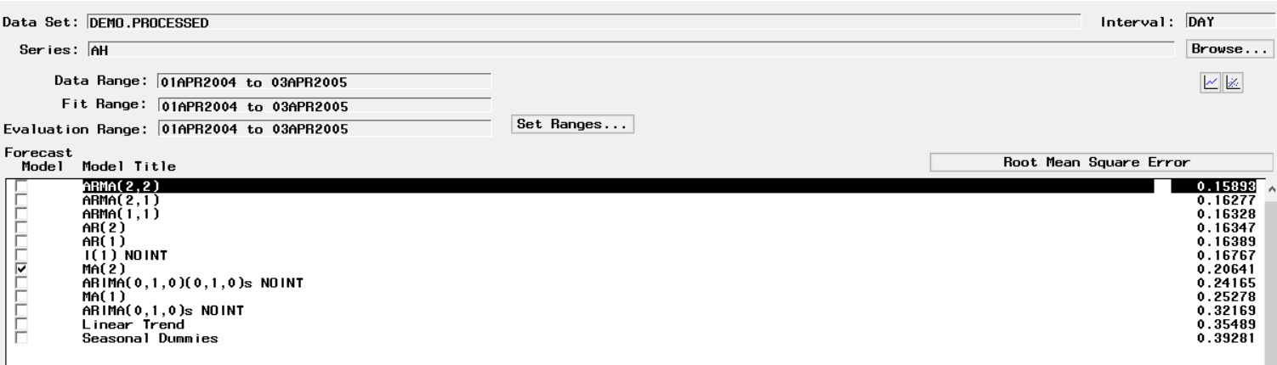
Modeling ARIMA for AH

Slide 30
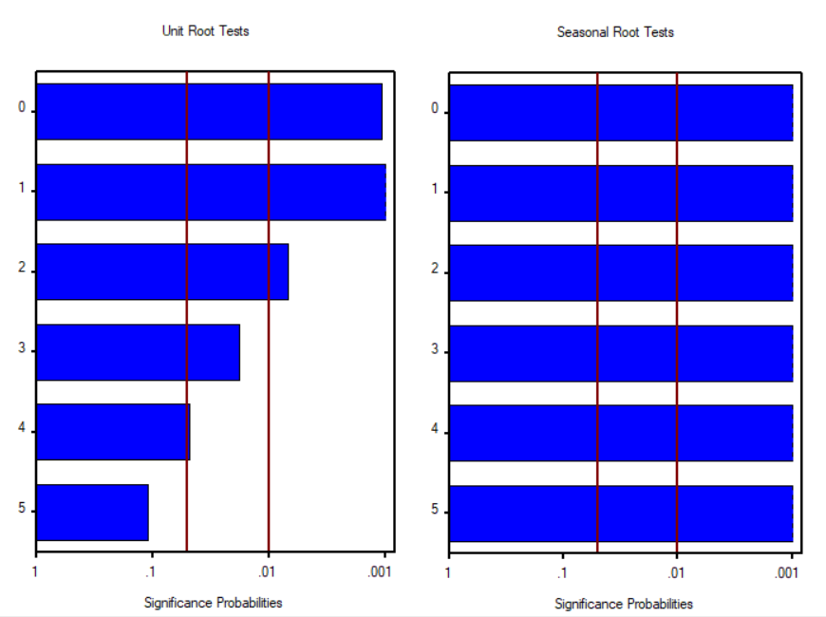
Stationary Check Before

Slide 31
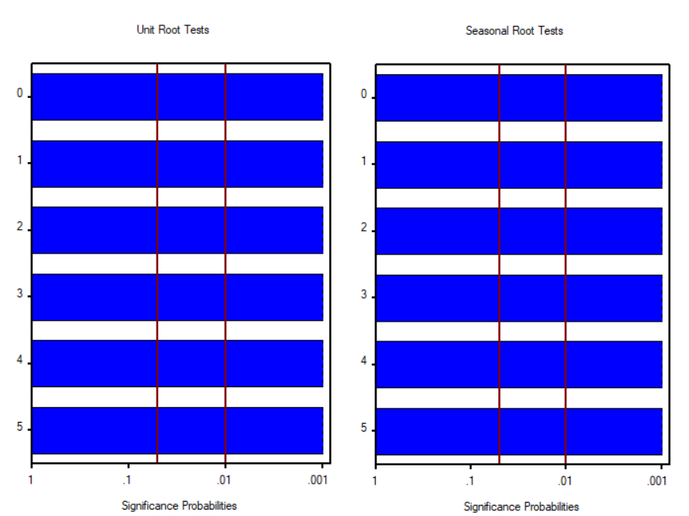
Stationary Check After

Slide 32
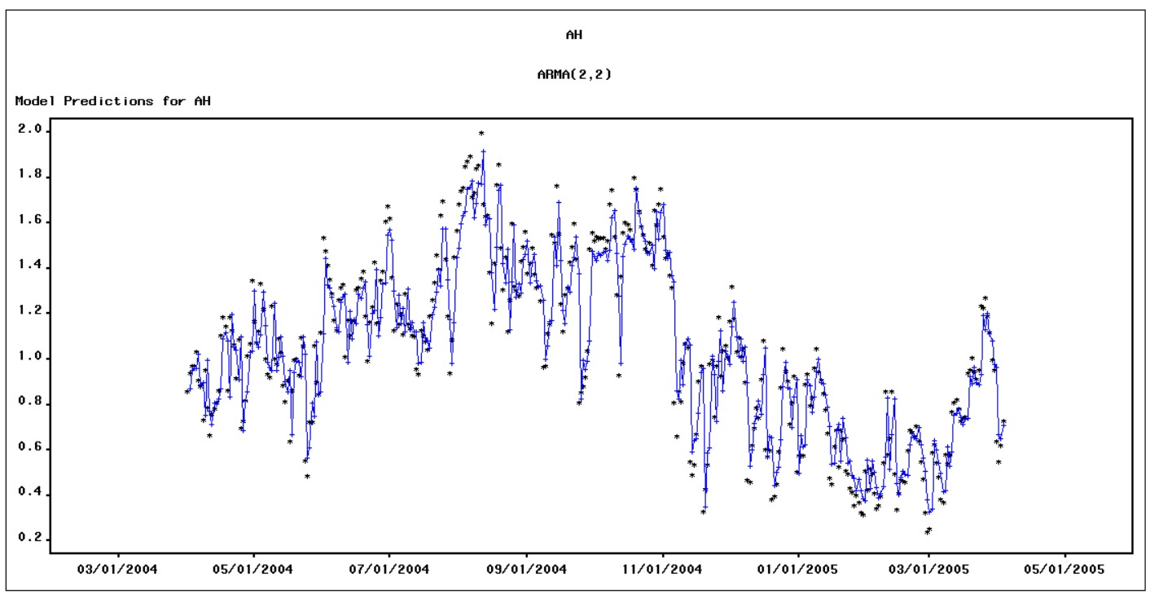
Model Prediction for AH

Slide 33
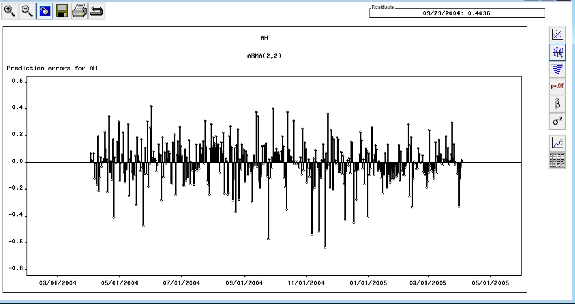
RMSE: 0.15893 MAPE: 13.84344 MAE: 0.11863 Mean Sq: 0.02526 R Sq: 0.838
Best Model: ARMA(2,2)

Slide 34
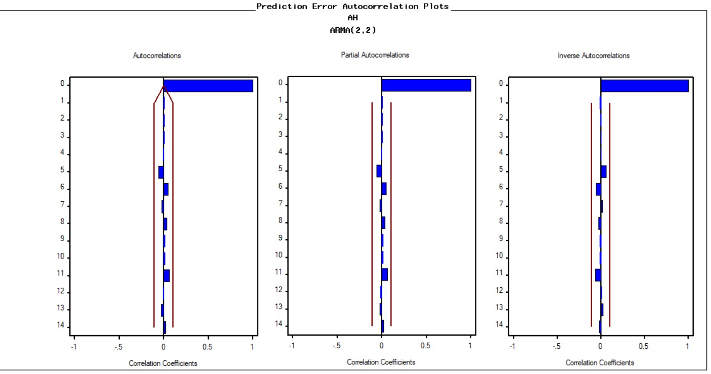
Prediction Errors

Slide 35
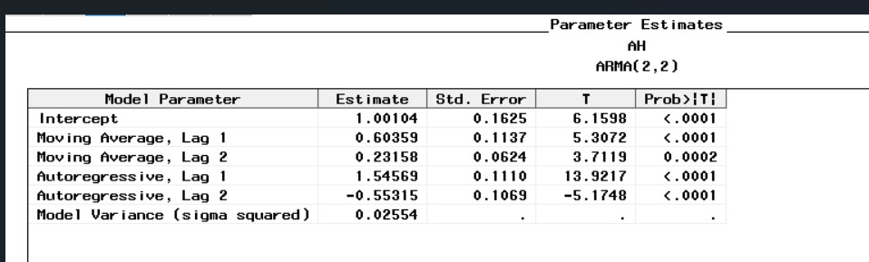
Parameter Estimates for AH

Slide 36
Business Insights
Monitoring and Compliance: Many companies, including those in the industrial, energy, and transportation sectors, release a massive amount of toxins into the environment. The injections make it harder for people and other species to survive. Monitoring air quality on a regular basis and assisting businesses in meeting regulatory criteria reduces the danger of air pollution in the environment.
Planning and Infrastructure development: The municipal planning commission can utilize AQI data and data models to plan the city's future. This information can assist them in identifying cities with high AQI and preventing them from granting authorization to polluting companies, which can then be used to optimize location and enhance trade-offs and transportation.
Insurance and Risk Management: AQI data may be used by insurance firms to analyze the hazards connected with air pollution and build risk management strategies. Insurers, for example, might use the data to assess the possible affects of air pollution on covered properties, predict the risks of health-related claims, and change their pricing and coverage appropriately.
Better Healthcare: Companies in the healthcare and wellness industries may use AQI data to better understand the health effects of air pollution and develop initiatives to enhance public health. The healthcare industry should promote fitness and wellbeing and encourage individuals to practice yoga, which could help people overcome respiratory illnesses while maintain a healthy lifestyle.

Slide 37
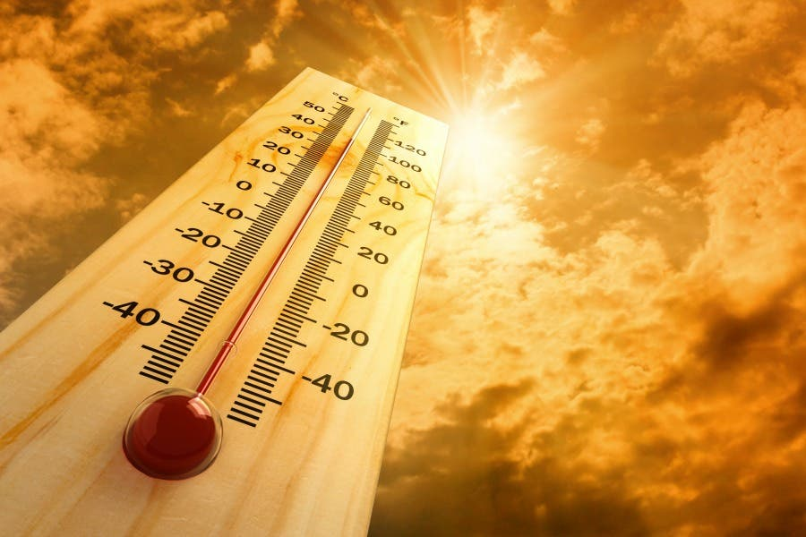
Thank you

